Slide 1

Car Challenge
The impact of the pandemic in the automotive industry
Team #6

Slide 2






Member's background
Diana Baltazar
Secretaría de Gobernación
Marco Cid
Public Accounting
and Financial Strategy
Perla Martinez
GM Financial
Freddy Reyes
Electrical Engineer
Tania Rosas
Oil & Gas
Javier Sada
Start up: Robots
Notes:
Por que elegimos este tema?
Por que la pandemia ha afectado el mercado
Debido al COVID muchas industrias cambiaron y el comportamiento proyectado por las empresas no fue el esperado
Se modifico la movilidad, como esto afecto a la busqueda de la gente de obtener su propio auto para evitar el contangio
La gente que salia por necesidad y queria evitar el contacto y como esto ayudo a la indutria

Slide 3
Motivation & Summary
Base on the data analysis, we want to demonstrate the effect of COVID-19 in the car industry.
How did COVID-19 impact the car industry? Why?
Describe whether you were able to answer these questions to your satisfaction, and briefly summarize your findings
Notes:
Por que elegimos este tema?
Por que la pandemia ha afectado el mercado
Debido al COVID muchas industrias cambiaron y el comportamiento proyectado por las empresas no fue el esperado
Se modifico la movilidad, como esto afecto a la busqueda de la gente de obtener su propio auto para evitar el contangio
La gente que salia por necesidad y queria evitar el contacto y como esto ayudo a la indutria

Slide 4
Questions
Does the pandemic reduce the number of car sales in Mexico?
Did people buy cars during the pandemic to avoid public transportation?
What are the car brands that sell more?
What was the actual car sales in 2020?
Does the stock price of the top brands increase or decrease?
What was the sale forecast for 2020 without Covid?
Notes:
Estas son las preguntas que buscamos responder con este análisis.
Hay varios cuestionamientos que se generaron a partir de nuestro análisis y tratamos de responder a continuación.

Slide 5
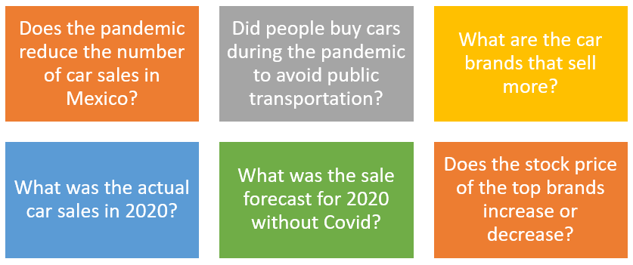
Datasets
INEGI 2005-2021
Registro administrativo de la industria automotriz de vehículos ligeros (nuevos y seminuevos)
Forecast on INEGI dataset
ALPHA VANTAGE
Free Stock Market API

Slide 6
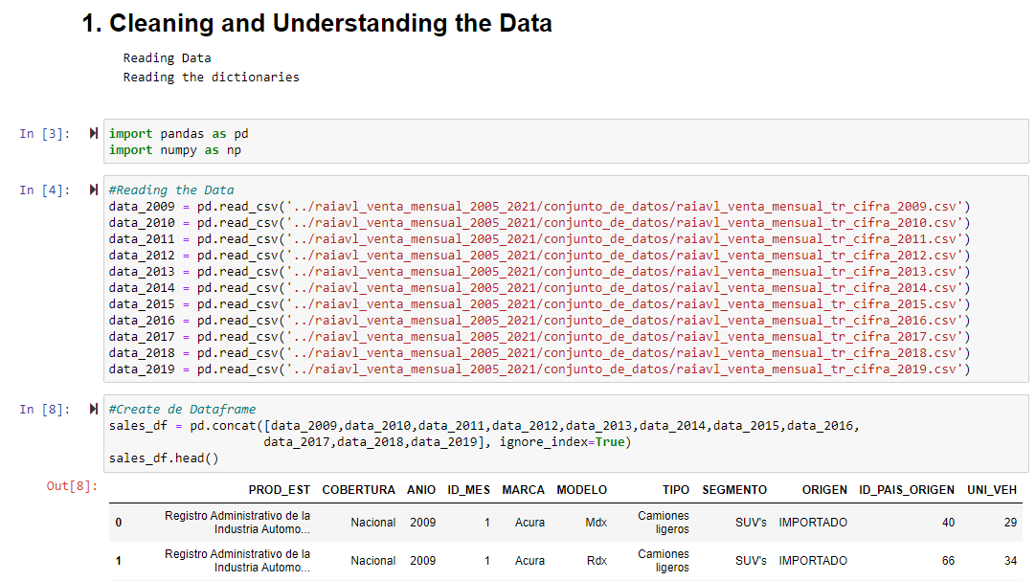
Data Cleanup & Exploration
INEGI 2009-2021
Select range 2009-2019
Excel export from INEGI
Consolidation into pandas
Notes:
Se descargo y se utilizo el formato en Excel

Slide 7
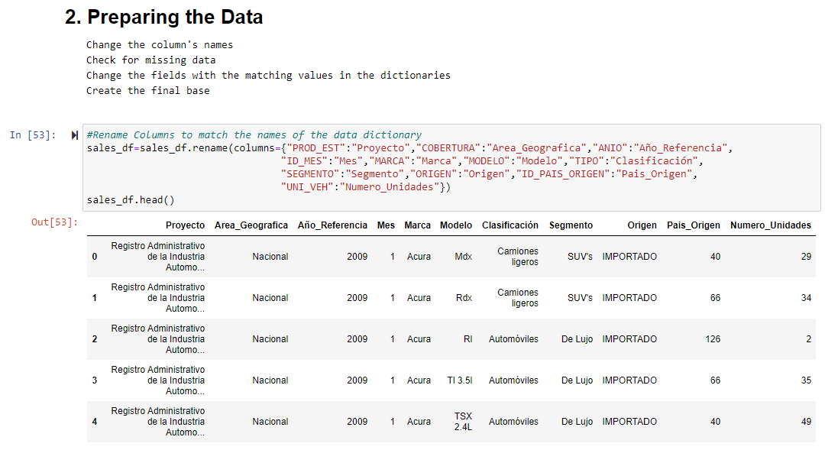
Data Cleanup & Exploration
INEGI 2009-2021
Select range 2009-2019
Excel export from INEGI
Consolidation into pandas
Cleaning process
Preparing data

Slide 8
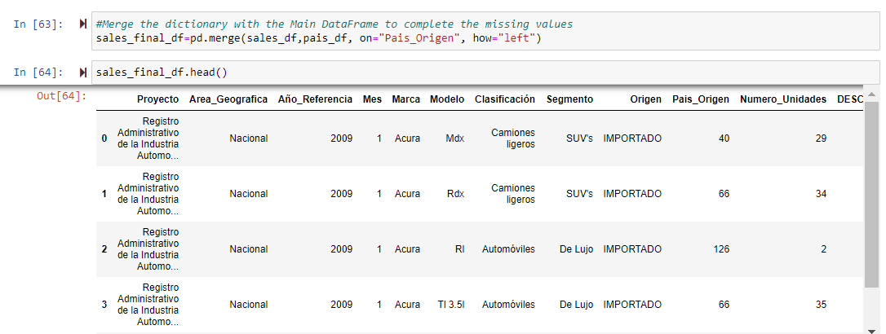
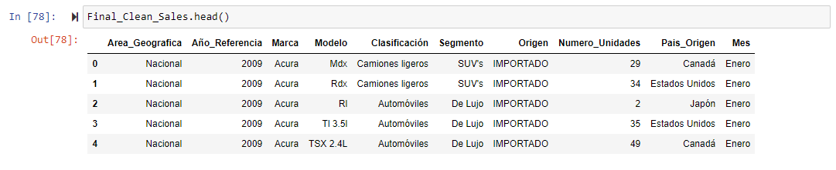
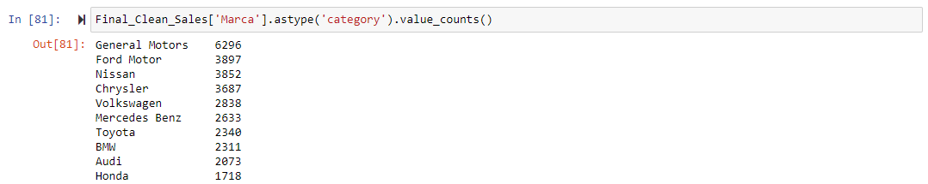
Data Cleanup & Exploration
INEGI 2009-2021
Select range 2009-2019
Excel export from INEGI
Consolidation into pandas
Cleaning process
Preparing data
…
…
Notes:
Top de marcas con mayor venta

Slide 9
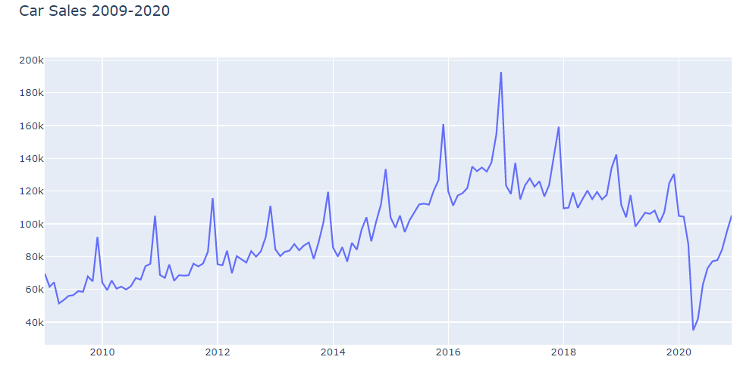
Data Cleanup & Exploration
INEGI 2009-2021
Select range 2009-2019
Excel export from INEGI
Consolidation into pandas
Cleaning process
Preparing data
Data exploration
Trend shows sales increase every year with a seasonal drop each January
2017 drop down sales due to T-MEC
Notes:
Agregar una flecha/animación para señalar el impacto
Titulo de la grafica

Slide 10
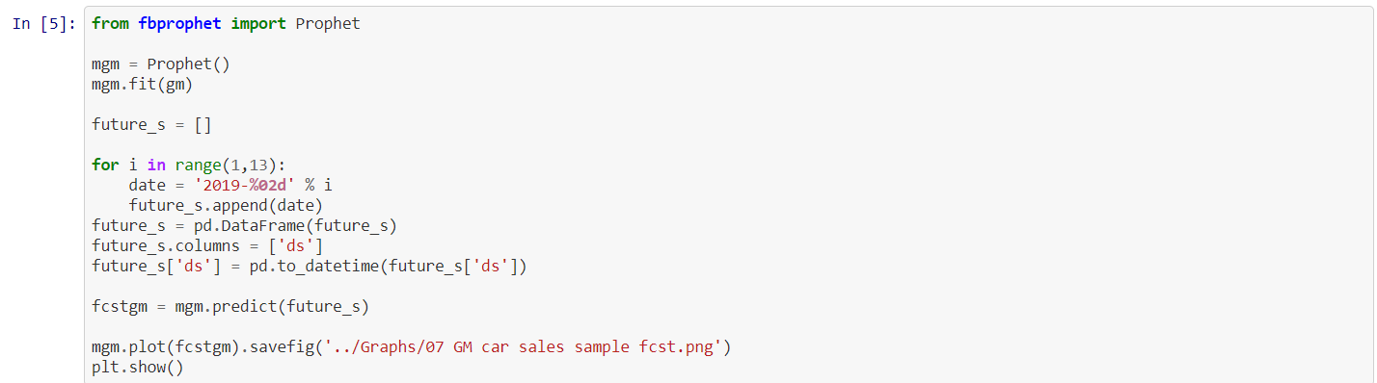
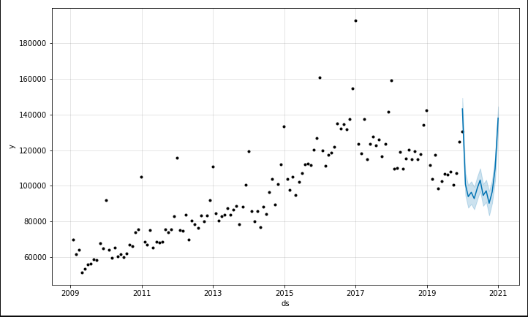
Data Cleanup & Exploration
INEGI 2009-2019
Forecast INEGI dataset for 2020 not considering actual 2020 sales
PROPHET
Prophet is an open-source library developed by Facebook and designed for automatic forecasting of univariate time series data.
Notes:
Prophet genera un rango predictivo para la tendencia basado en los datos de INEGI 2009-2019

Slide 11
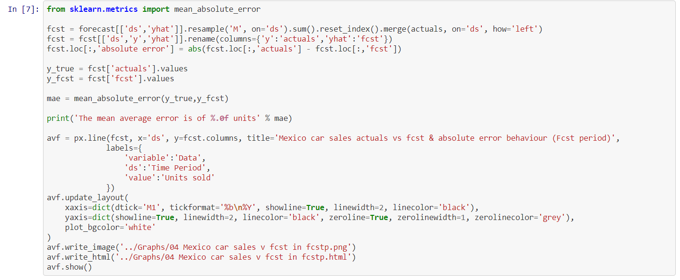
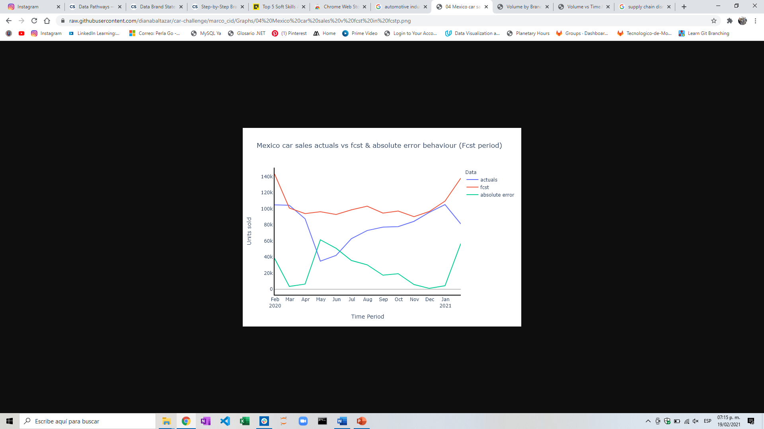
Data Cleanup & Exploration
Forecast 2020
Load & summarize dataset
Load & plot dataset
Forecast car sales 2020 with prophet
Fit Model
Make in-sample forecast
Make out-of-sample forecast
Insights: The biggest difference is shown April, after lockdown
Problems: Due to the limited number of variables used to train the model, this forecast shows an error of 25,000 units
Notes:
Aquí se observa la tendencia utilizando el forecast en rojo vs las ventas reales en azul, el margen de diferencia se grafica en la línea verde

Slide 12
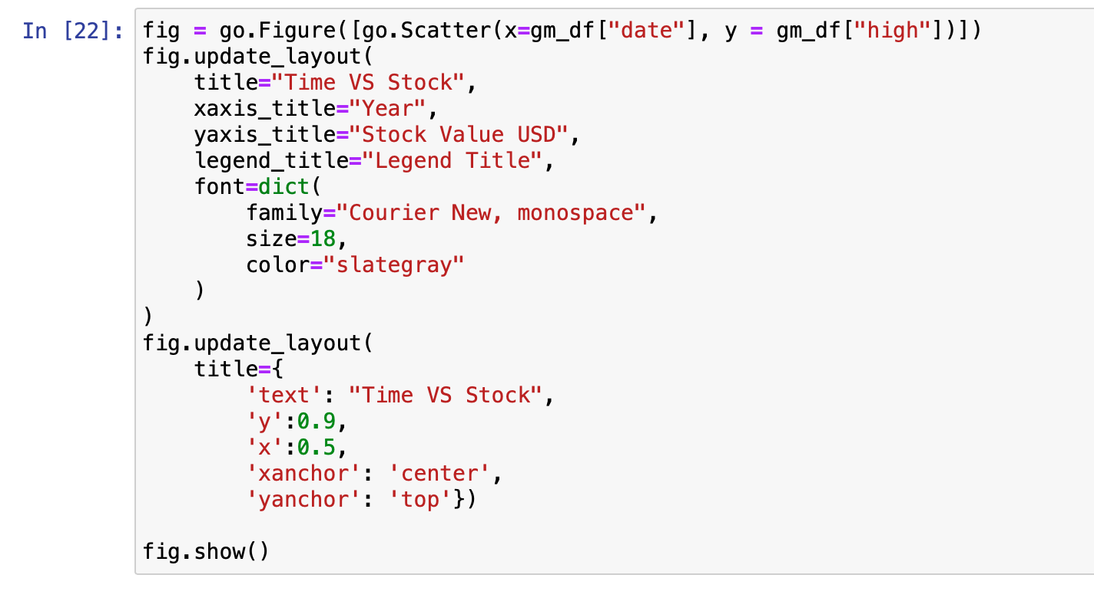
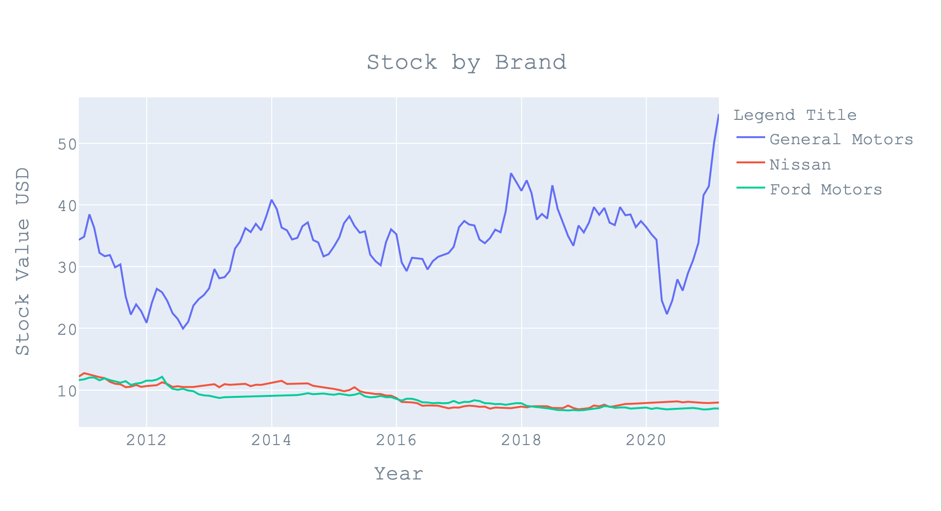
Data Cleanup & Exploration
ALPHA VANTAGE
Free Stock Market API
The ticker names were searched manually to be consulted using the API
Ticker | Company Name
GM | General Motors Company
Ford | Ford Motor Company
NSANY | Nissan Motor Co., Ltd. (ADR)

Slide 13
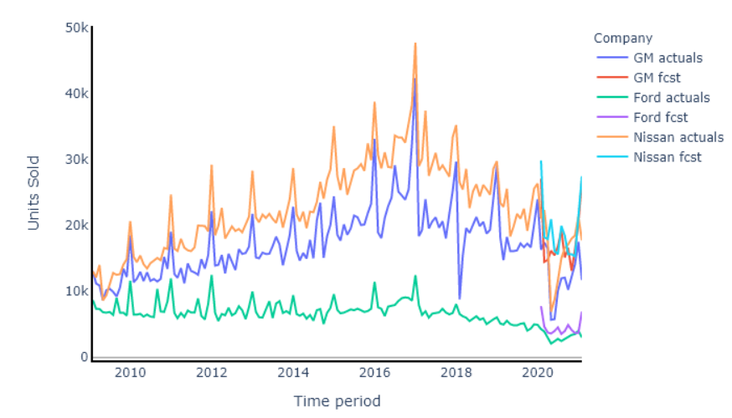
Data Analysis
Notes:
The COVID-19 outbreak and resulting economic uncertainty may likely reduce consumer demand in the short term, possibly leading to dampened new vehicle sales and deferred spending on nonessential maintenance. In the longer run, these forces could trigger a shift in consumer preferences, much as other global events with significant macroeconomic implications (e.g., wars, oil price swings, etc.) have done.

Slide 14
Discussion
Car Sales Drop
Macroeconomic uncertainty fueled by COVID-19’s global spread and supply chain disruptions combined with the significant resulted in a mean absolute error of 25,000 units in 2020.
Stock Price
Fiscal support was injected in the stock exchange as part of the crisis management response from the US government and we see the value of the tickers increased during 2020.
Using the stock price was not a clear support of our hypothesis.

Slide 15
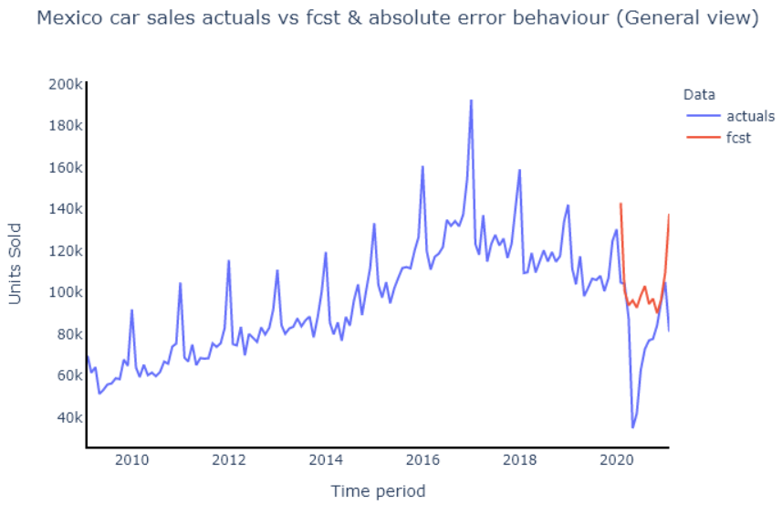
Postmortem
Semáforo de movilidad (Mexico)
https://datos.cdmx.gob.mx/dataset/afluencia-preliminar-en-transporte-publico/resource/5d33f9c7-e033-4676-a02d-9e2129017acf
SEMOVI - API

Slide 16

Questions?

